Slide 1
INDIA’S BIGGEST
OPEN TRIATHLON

Slide 2
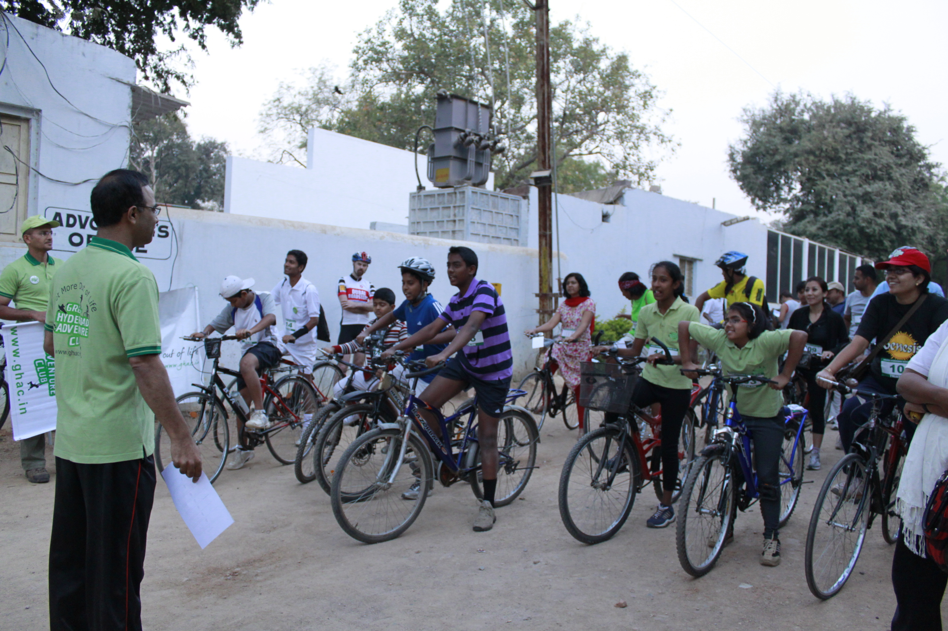
THE HISTORY
GHAC introduced the first ever Triathlon in Hyderabad on July 31 2011.

Slide 3
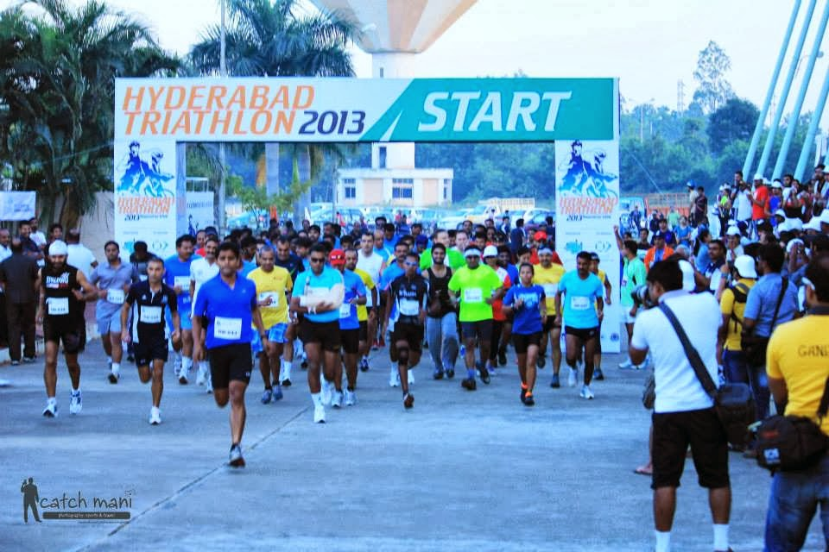
GROWING BIGGER
PARTICIPANTS
Feb 26th 2012 : 150
Oct 14th 2012 : 300
Oct 20th 2013 : 630

Slide 4
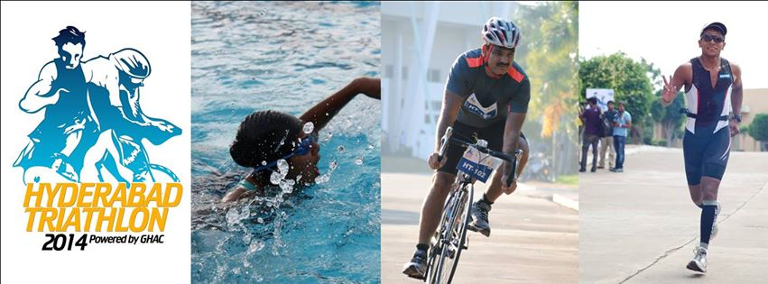
WHAT IS A TRIATHLON?
A Triathlon involves three sporting disciplines: Swimming, Cycling and Running.

Slide 5
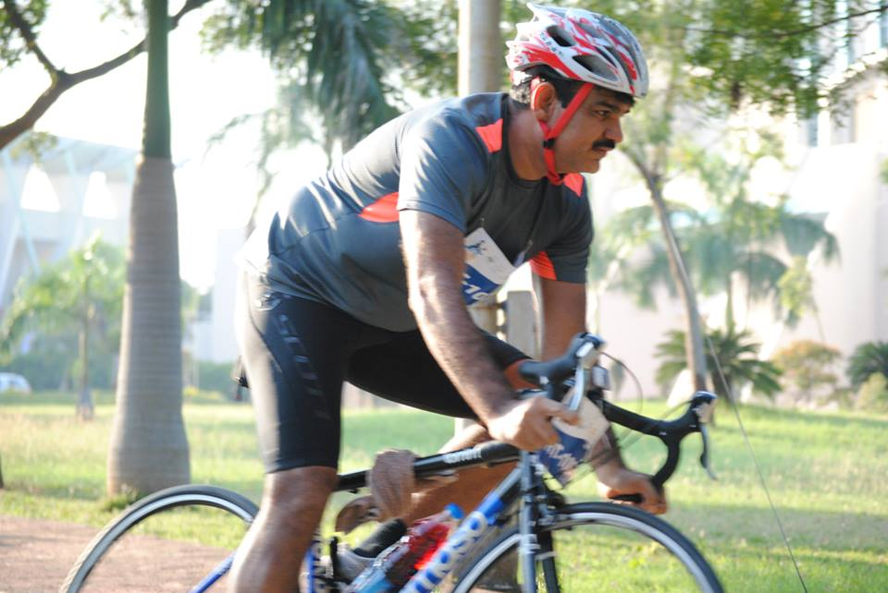
OBJECTIVE OF TRIATHLON?
Create awareness about the Triathlon among the general public,
Improve physical and mental fitness of the participants,
Making it a family-friendly event to encourage participation of families and promote a healthier lifestyle.

Slide 6
2014: ACROSS TWO LOCATIONS
The 5th edition of Hyderabad Triathlon will be held on 12th October 2014, across two locations in the twin cities.
Gachibowli Sports Complex and ICFAI, Dontampally.

Slide 7
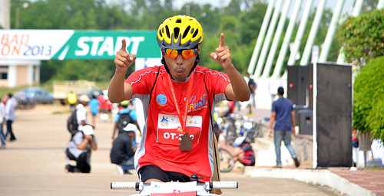
CHOOSE YOUR CHALLENGE
9 Events
5 Triathlon
4 Duathlon

Slide 8
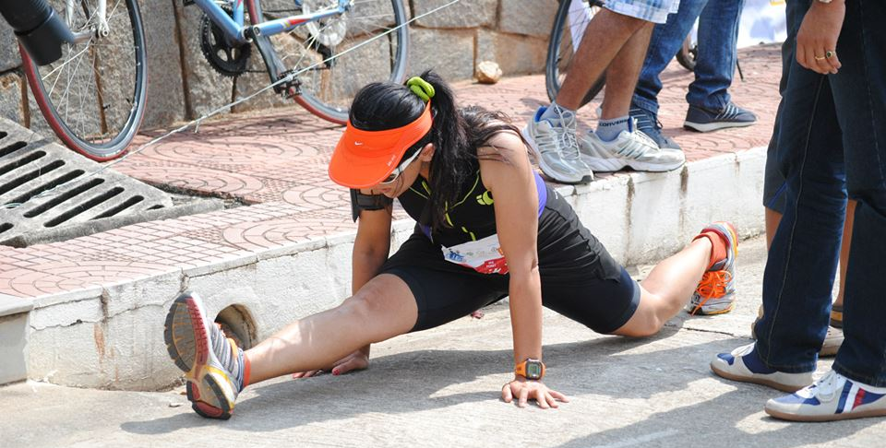
WHAT IS NEW?
Introduction of two new categories – 3/4 Iron Man Triathlon & Power Duathlon

Slide 9
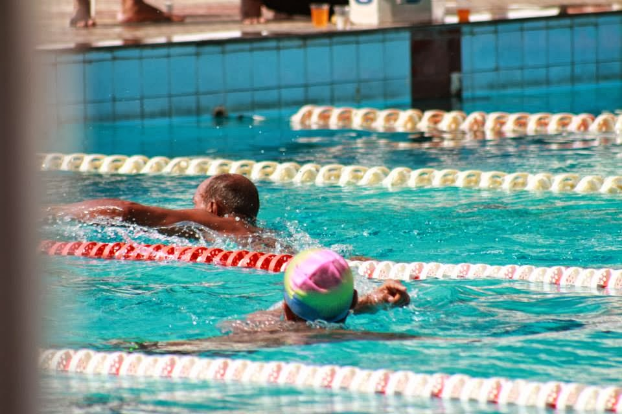
THE TOUGH ONES

Slide 10
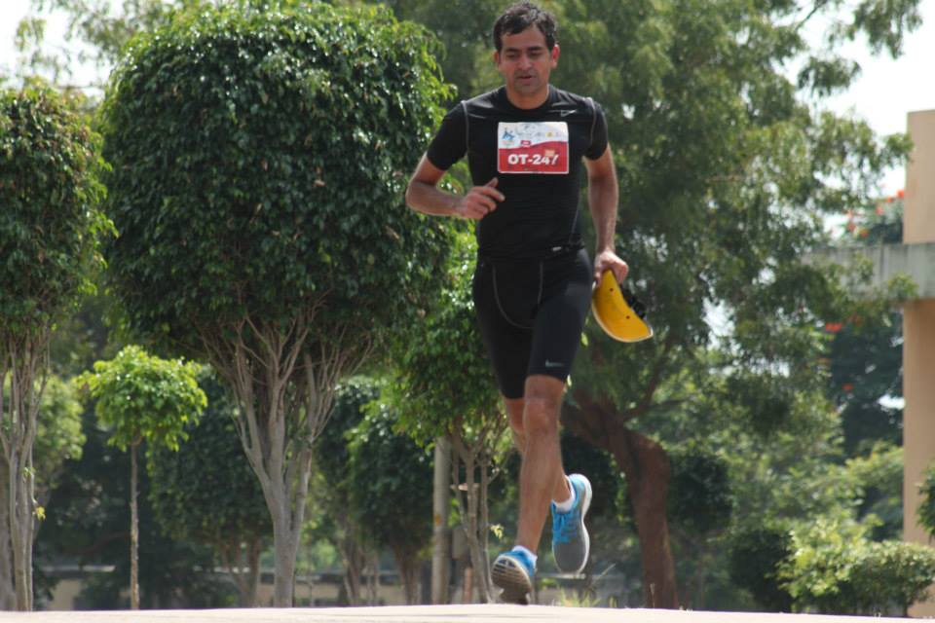
THE TOUGH ONES

Slide 11
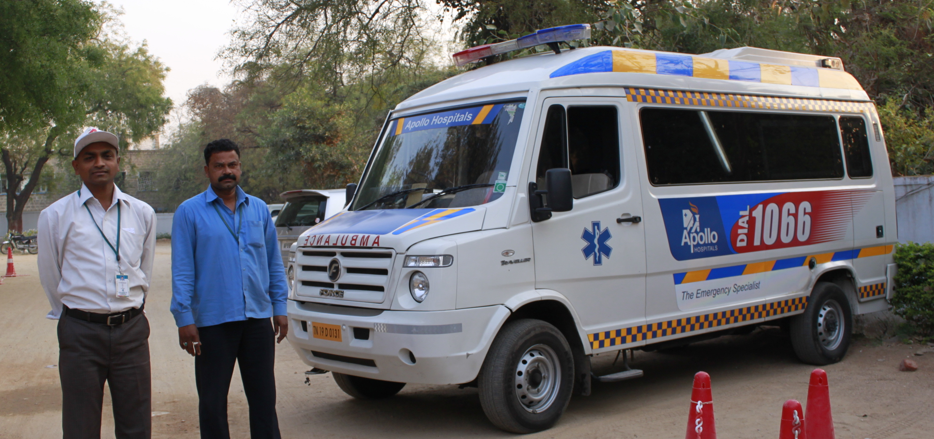
SAFETY AND SUPPORT
Medical Support
Water and Refreshments along the route
Route Marshalling

Slide 12
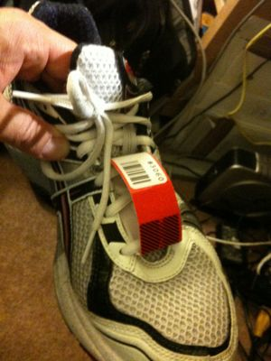
TIMING CHIPS
For the first time all participants in professional level events of Hyderabad Triathlon will wear timing chips.

Slide 13
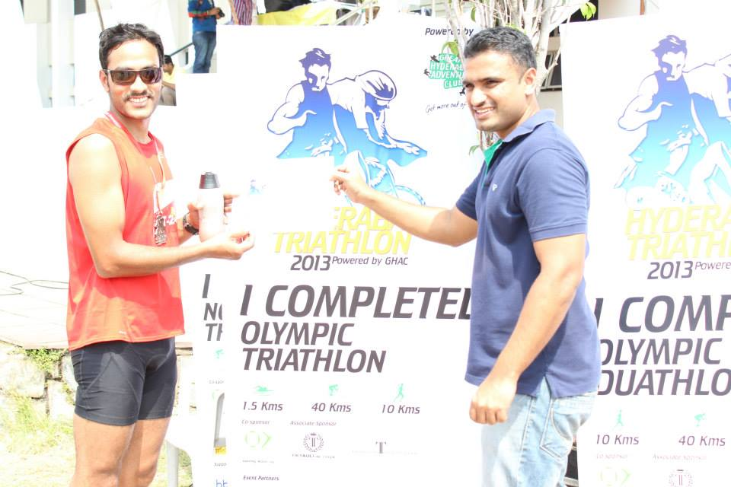
EVERYONE IS A WINNER
All finishers will get a medal and a certificate.

Slide 14
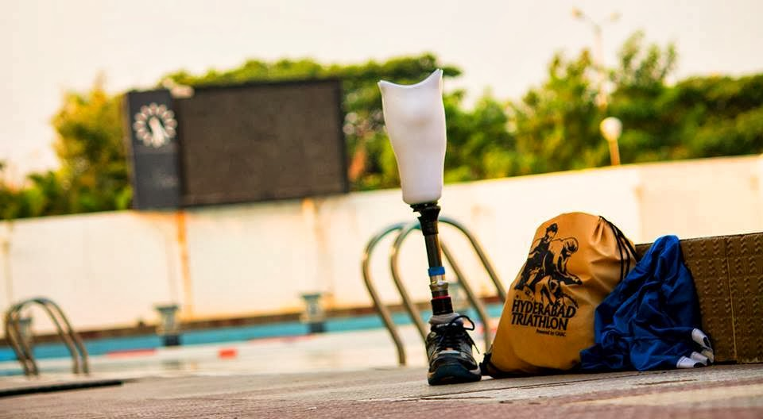
ARE YOU READY?

